Slide 1
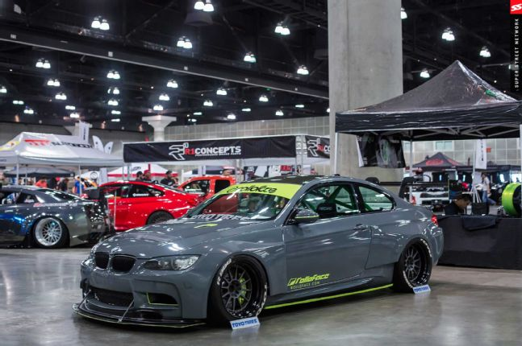
Hayden’s website
Car enthusiast, which means i will be posting a lot of things about car events and races, etc
The page will consist of 2 pages!
I would like to incorporate an introduction to the website (intro/transition into the website)
Specifically cars that you would see on like fast and furious

Slide 2
Hayden’s website
I would like for the introduction to be a drive through a tunnel and then present the car
https://www.youtube.com/watch?v=MwHT32wM0_A (something like this)
The car will then be presented as a picture and would be able to navigate around and hover on things on the car
Would want to do little pop ups when clicked on anything the car has

Slide 3
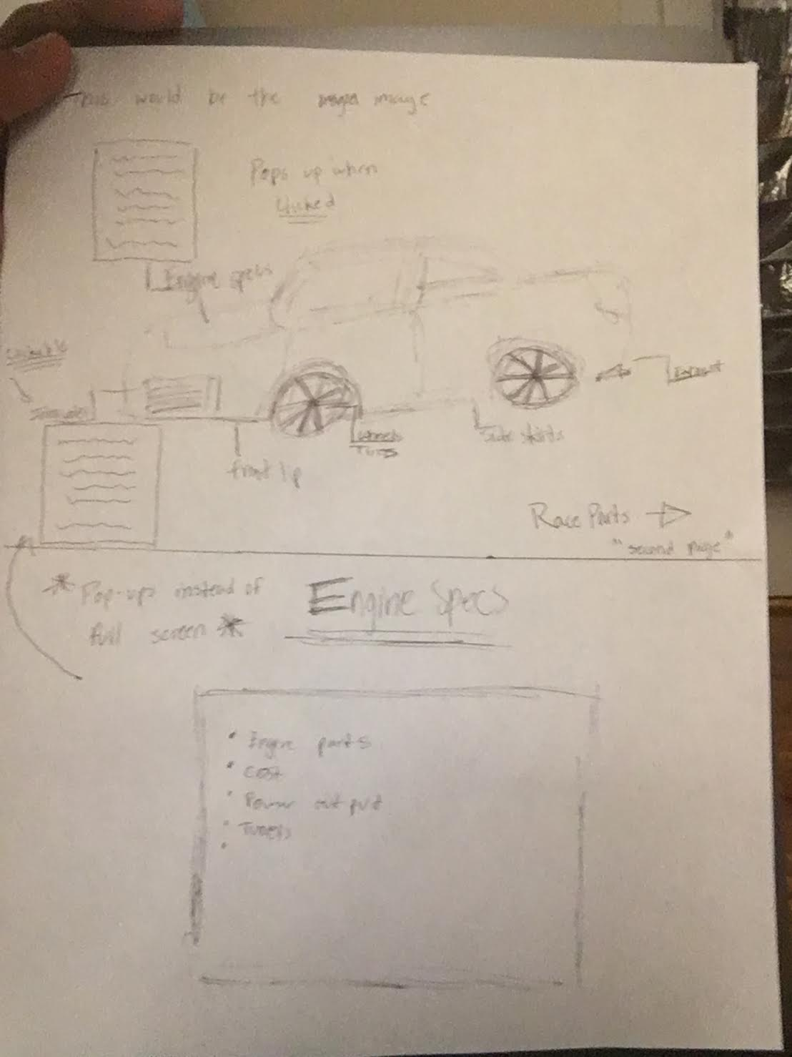
Hayden’s website
The second page will include places and things in which you can buy official car parts for that specific car
Tuners
Car events
Where to sell your car parts or trade
The color would most likely be dark possibly black to compliment the car im doing the project on

Slide 4
Hayden’s website
First page image of car with clickable features
Pop ups
Second page would include info on where to get the parts
The pop ups might include iframe videos first then be able to scroll down for more info

